Slide 1
Service Function Path Provisioning With Topology Aggregation in Multi-Domain Optical Networks
B Yan, Y Zhao, X Yu, Y Li, S Rahman, Y He, X Xin, J Zhang
Presenter: Congzhou Li

Slide 2
Contents
Introduction
Problem Statement
Aggregation Algorithm
Data Structure for Aggregation
Cross-Domain Routing Algorithm
Simulation Results
Conclusion

Slide 3
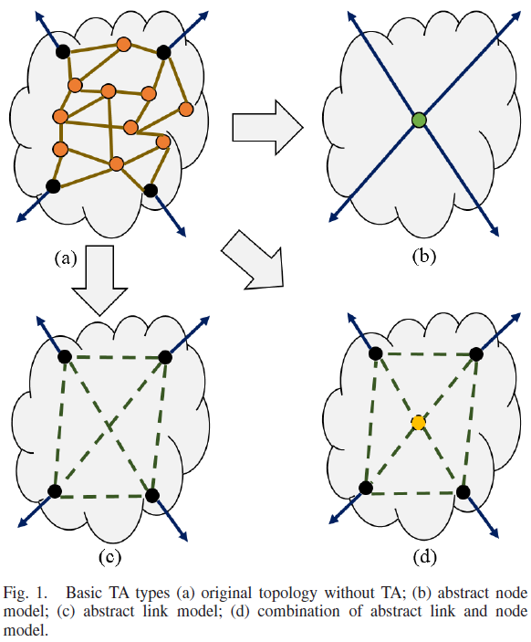
Introduction
The benefit of Topology Aggregation (TA).

Slide 4
Introduction
The main contribution:
1) TA algorithm:
SFC-Oriented(SOTA).
2) New data structure:
wheel matrix.
3) SFP provisioning algorithm:
Ordered Anchor Selection (OAS), K-path OAS (K-OAS).

Slide 5
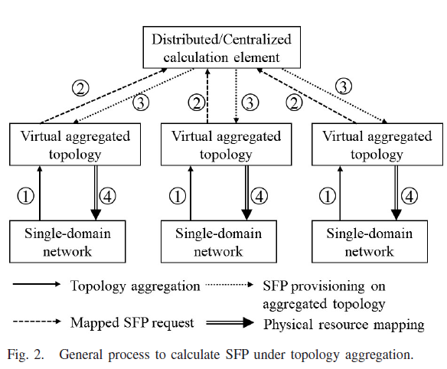
Problem Statement
Cross-domain SFP provisioning in multi-domain networks

Slide 6
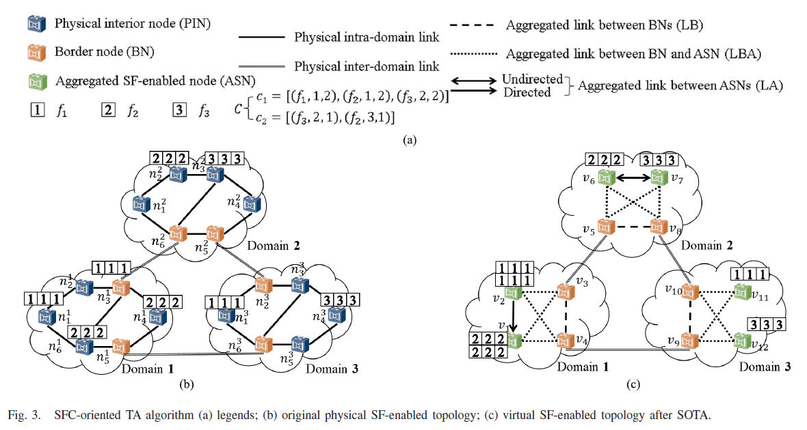
Aggregation Algorithm
A. Node Aggregation:

Slide 7
Aggregation Algorithm
B. Link Aggregation:

Slide 8
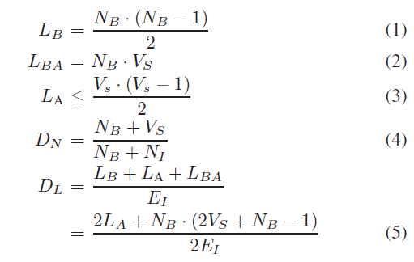
Aggregation Algorithm
C. Node & Link Aggregation Degree:

Slide 9
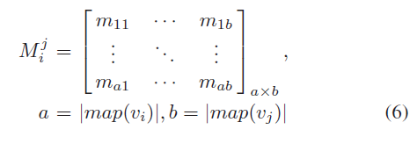

Data Structure for Aggregation
Wheel Matrix:
a matrix containing the connection information from
aggregated nodes.

Slide 10
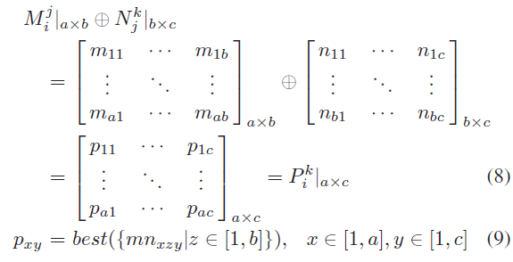
Data Structure for Aggregation
A. Roll Operation:
A new traversal rule on AT.

Slide 11
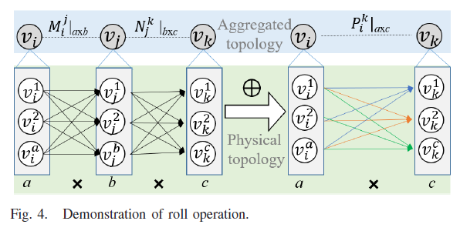
Data Structure for Aggregation
A. Roll Operation:
A new traversal rule on AT.

Slide 12
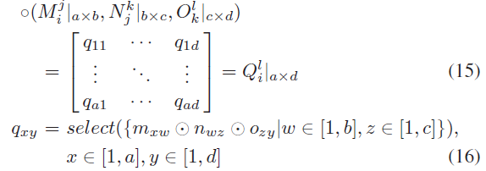
Data Structure for Aggregation
B. Continuous Roll Operation:
For multi-segment routing calculation.

Slide 13
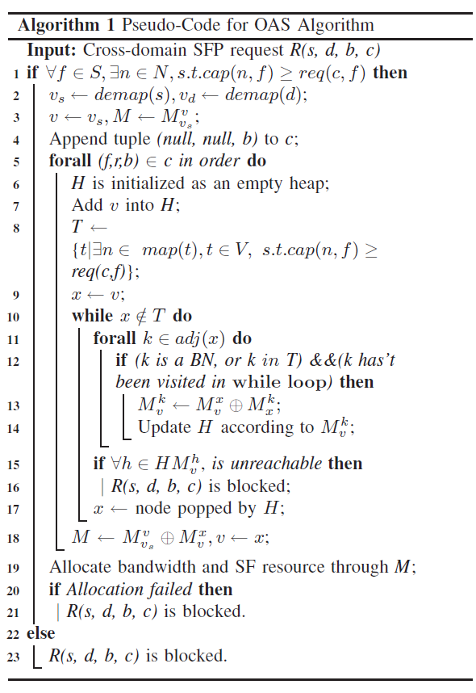
Cross-domain Routing Algorithm
Ordered Anchor Selection (OAS) algorithm:
the selected optical node connecting a DC is called anchor node.

Slide 14
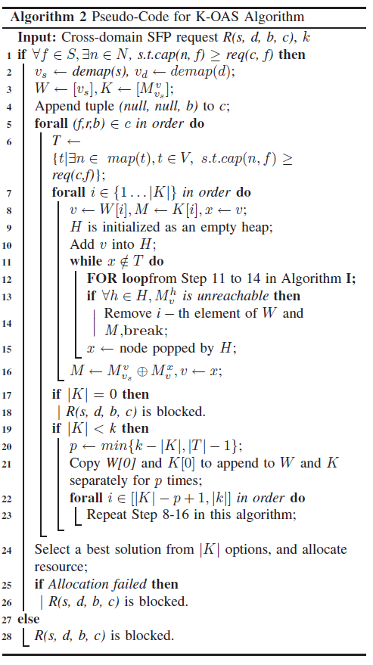
Cross-domain Routing Algorithm
B. K-OAS algorithm:
search more
available paths on aggregated topology.

Slide 15
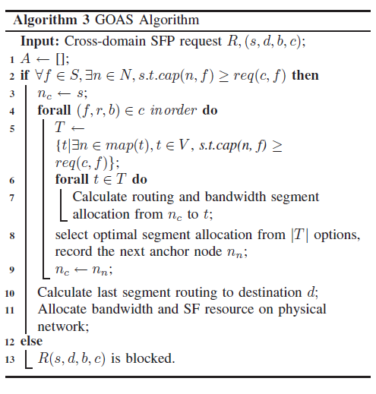
Cross-domain Routing Algorithm
C. G-OAS algorithm:
A non-aggregated version
of OAS.

Slide 16
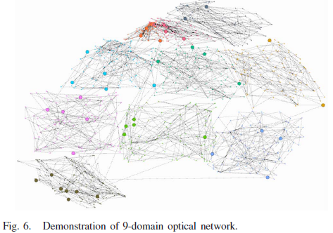
Results and Discussion
Test topology

Slide 17
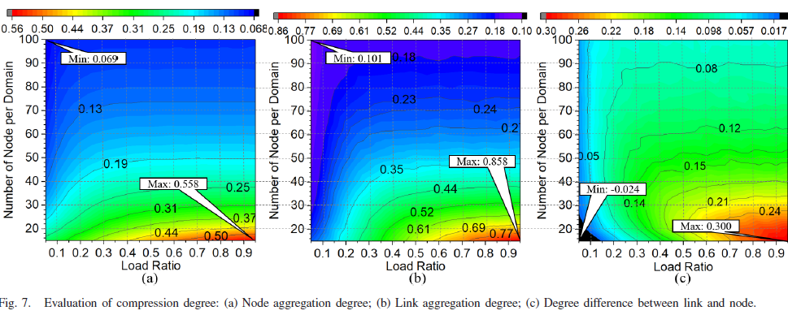
Results and Discussion
A. Aggregation Degree

Slide 18
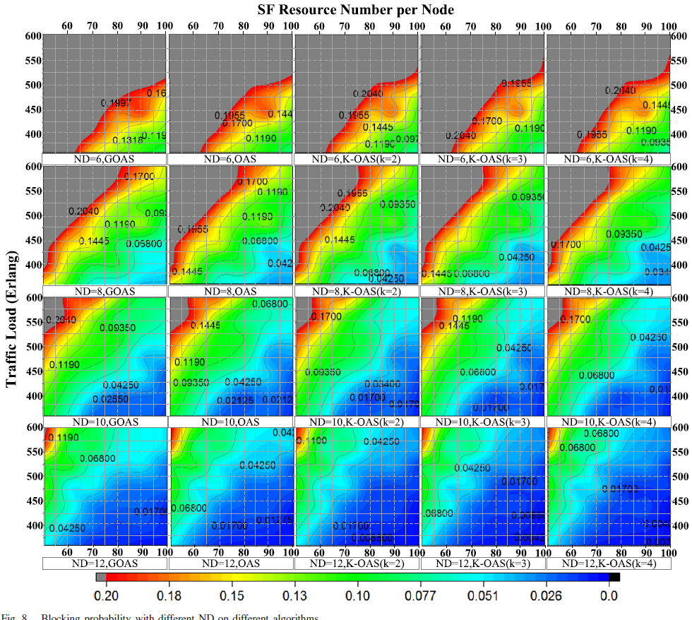
Results and Discussion
B. Blocking Probability

Slide 19
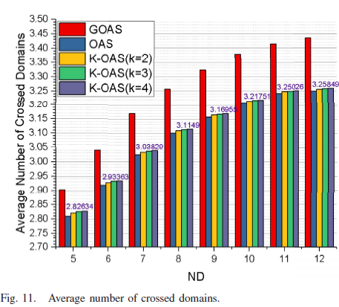
Results and Discussion
C. Number of Crossed Domain

Slide 20
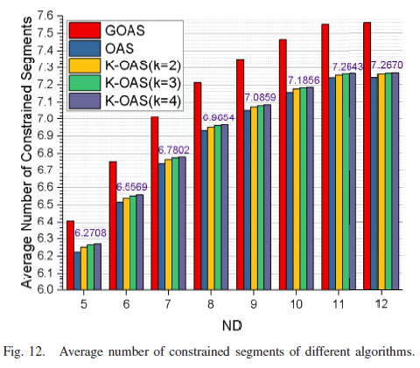
Results and Discussion
D. Constrained Segments

Slide 21
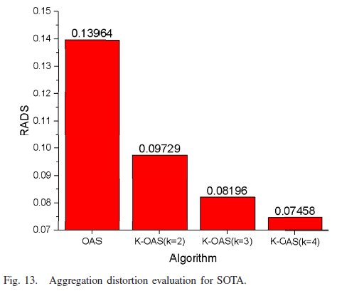
Results and Discussion
E. Aggregation Distortion

